Slide 1

Exploring Microsoft Office Access 2010
Chapter 2:
Relational Databases and Multi-Table Queries
1

Slide 2
Objectives
Design data view
Create tables (data types and properties)
Understand table relationships
Establish table relationships
Share data with Excel
Notes:
Objectives for the chapter are: design data, create tables, understand table relationships, share data with Excel and establish table relationships.

Slide 3
Objectives
Create a query using Query Design View
Specify criteria for different data types
Copy and run a query
Use the Query Wizard
Understand large database differences
Notes:
Objectives for this chapter also include: Create a query, Specify criteria for different data types, Copy and run a query,
Use the Query Wizard and Understand large database differences.

Slide 4
Five different ways to create tables
Using Table Wizard
Using data sheet view
Using design view
Creating tables with queries
Creating tables by importing external data sources

Slide 5
Creating a Table by Using the Table Wizard (available only by older versions)
Microsoft Access has a wizard named the Table Wizard that will create a table for you. This wizard gives you suggestions about what type of table you can create (for example, a Mailing List table, a Students table, a Tasks table, and so on) and gives you many different possible names for fields within these tables.

Slide 6
Creating a Table by Entering Data in a Datasheet (create tab)
In Microsoft Access, you can also create a table by just entering data into columns (fields) in a datasheet. If you enter data that is consistent in each column (for example, only names in one column, or only numbers in another column), Access will automatically assign a data type to the fields.
Use a table template
  From the Create Tab, click Table Templates

Slide 7
Creating a Table in Design View
If you want to create the basic table structure yourself and define all the field names and data types, you can create the table in Design view.

Slide 8

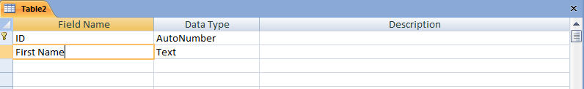
Create Tables – Design View
Table Design View
Table View
Add field in Table View
After choosing your method of creation begin implementing the table design
  Specify data types
  Establish a primary key
  Consider the need for a foreign key
Notes:
After choosing your method of creation begin implementing the table design. Be sure to use CamelCase notation for field names. You will also need to specify the data type for each field and establish the primary key that was determined when planning your table.

Slide 9
Creating a Table with a Query
A make table query retrieves data from one or more tables, and then loads the result set into a new table. That new table can reside in the database that you have open, or you can create it in another database.

Slide 10
External Data Sources- Import Tab
Import the data into a new Microsoft Access table, which is a way to convert data from a different format and copy it into Microsoft Access. You can also import database objects into another Microsoft Access database.
Import types such as:
  dbase, excel, outlook, Sharepoint, Lotus, Paradox, text (.txt,.csv,.tab, .asc), Link, xml, other Access Files, ODBC

Slide 11
External Data Sources
Link to the data, which is a way to connect to data from another application without importing it so that you can view and edit the data in both the original application and in an Access file.

Slide 12
Name fields clearly
Choose field names that will be easily understood by the people who will use the database. If your organization has other databases, you should check to see if it has conventions for naming database fields.
Although you can add or change a table's field names in Datasheet view, the best place to update a table's fields is in Design view. There, you can easily add and rename fields, add descriptive text, and set the field data type and properties.

Slide 13
Set data types for fields
The data type of a field is an attribute of the field's stored data. Proper selection of data type provides major advantages:
  Control - Data type determines what kinds of information may be stored in the field, preventing errors and enhancing data validation. Setting data type to Number, for example, prevents invalid text entry.
  Convenience - Data type can help manage database disk-space requirements and speed up performance. Setting data type to Number, for example, will typically make calculations faster.

Slide 14
Data Types of Fields
Attachment Files, such as digital photos. Multiple files can be attached per record. This data type is not available in earlier versions of Access.
AutoNumber Numbers that are automatically generated for each record.
Currency Monetary values.
Date/Time Dates and times.
Hyperlink Hyperlinks, such as e-mail addresses.
Memo Long blocks of text and text that use text formatting. A typical use of a Memo field would be a detailed product description.
Number Numeric values, such as distances. Note that there is a separate data type for currency.
OLE Object OLE objects (OLE object: An object supporting the OLE protocol for object linking and embedding.
Text Short, alphanumeric values, such as a last name or a street address.
Yes/No Boolean values
Lookup Wizard
2814 Notes Chapter 2

Slide 15
Set field properties
A field property is an attribute of a field that controls the display and user input of data.
Proper selection of field properties ensures that data will be seen and entered in the same way throughout your database, including forms, queries, and reports that use the data.
If you set the field property for a date to Input Mask, you establish a single pattern for this data entry. Thus you can ensure that this information is always entered in the format 04/24/2008.
You can decide whether you want the figures in the mask, such as dashes or slashes, to be stored as part of your data, or whether you just want to store the numbers of the date.

Slide 16
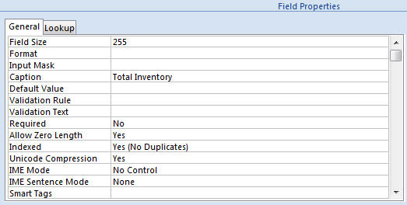
Work with Properties
Field Size property
Caption property
Field Properties can be used to specify characteristics for individual fields
Located in the lower pane of Table Design View
Notes:
Field Properties can be used to specify characteristics for individual fields. Field Properties can be found in the lower pane of the Table Design View.

Slide 17
Properties (1 of 2)
2814 Notes Chapter 2
Field size- Adjusts the size of the text field
Format- changes the way field is displayed. Does not effect the value.
Input Mask- facilitates data entry
Caption- Label used for the field
Default Value- the automatically entered value

Slide 18
Examples for Format property
Format property for Number data type:
#,###.##;(#,###.##)[Red];0,000.00;“Undefined”
format for positive
number
format for 0
format for null-value
format for negative
number
6,789.77

Slide 19
Examples for Input Mask property
Input mask forText data type:
!\(999") "000\-0000;0;_ - (204) 888-1234
>!“FJ”\-AA\-00000 – FJ-EA-12048
Input mask forTime data type
99:00:00\ >LL;0;_ - 05:56:00 PM

Slide 20
About Input Mask property
An input mask is a string of characters that indicates the format of valid input values. You can use input masks in table fields, query fields, and controls on forms and reports. The input mask is stored as an object property.
You use an input mask when it’s important that the format of the input values is consistent. For example, you might use an input mask with a field that stores phone numbers so that Access requires ten digits of input. If someone enters a phone number without the area code, Access won’t write the data until the area code data is added.

Slide 21
The three parts of an input mask
Input masks are made up one mandatory part and two optional parts, and each part is separated by a semicolon. The purpose of each part is as follows:
The first part is mandatory. It includes the mask characters or string (series of characters) along with placeholders and literal data such as, parentheses, periods, and hyphens.
The second part is optional and refers to the embedded mask characters and how they are stored within the field. If the second part is set to 0, the mask characters are stored with the data, and if it is set to 1, the characters are only displayed and not stored. Setting the second part to 1 can save database storage space.

Slide 22
The three parts of an input mask
The third part of the input mask is also optional and indicates a single character or space that is used as a placeholder. By default, Access uses the underscore (_). If you want to use another character, enter it in the third part of your mask.

Slide 23
The three parts of an input mask
Characters that define input masks
 | explanation
0 | User must enter a digit (0 to 9).
9 | User can enter a digit (0 to 9).
# | User can enter a digit, space, plus or minus sign. If skipped, Access enters a blank space.
L | User must enter a letter.
? | User can enter a letter.
A | User must enter a letter or a digit.
a | User can enter a letter or a digit.
 | User must enter either a character or a space.
&
C
 | User can enter characters or spaces.

Slide 24
Characters that define input masks
 | explanation
. , : ; - / | Decimal and thousands placeholders, date and time separators. The character you select depends on your Microsoft Windows regional settings.
> | Coverts all characters that follow to uppercase.
< | Converts all characters that follow to lowercase.
! | Causes the input mask to fill from left to right instead of from right to left.
\ | Characters immediately following will be displayed literally.
"" | Characters enclosed in double quotation marks will be displayed literally.

Slide 25
Properties (2 of 2)
2914 Notes Chapter 2
Validation Rule- Rejects records that do not conform to rules entered.
Validation Text- Error returned when validation rule is broken.
Required- Forces user to enter in value if selected.
Allow Zero Length- Allows text length of 0.
Indexed- increases efficiency of search on the field

Slide 26
Validation rules:
Example | Matches...
>#28/2/1990# | Dates after 28 February 1990
Between #28/2/1990# And #5/3/1990# | Dates between 28 February and 5 march 1980
>= #28/2/1980# And <= #5/3/1990# | Dates between 28 February and 5 march 1980
> #28/2/1990 13:45# | Date/Time after 28 February 1990 13:45
> Date() | Dates after todays date
> Now() | Date/Time after the current Date/Time

Slide 27
Validation rules:
Example | Matches...
> 0 | Positive numbers only, excluding 0
>= 0 | Positive numbers only, including 0
>= 0 And <= 100 | Between 0 and 100, including 0 and 100
Between 0 And 100 | Between 0 and 100, including 0 and 100
In(1,2,3,4,5) | 1,2,3,4 or 5
1 Or 2 Or 3 Or 4 Or 5 | 1,2,3,4 or 5

Slide 28
Table Design Considerations
Just as you first create a blueprint to build a house, you should first sketch or outline the design of a database table.
Careful pre-planning will save you much time in the future.
Notes:
Just as you first create a blueprint to build a house, you should first sketch or outline your table design. (Add: Careful pre-planning saves you much time in the future. There are many factors that affect both the design and structure of a database.

Slide 29
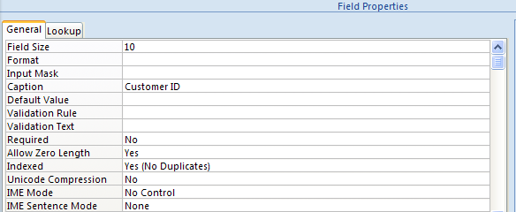
Table Design Considerations –
Field Size Property
Set field size in the Field Properties
grid of Table Design View
Set the field size in Table Design View
Always anticipate the current field size may one day need to be larger
Notes:
Set the field size property of individual fields in Table Design View. Once the field size is set, data entry in that field is limited to the length specified. In order to prepare for the future, always anticipate the current field size may one day need to be larger.

Slide 30
Design for the Next 100 Years
Good design must balance the current and future needs of the system against the cost of recording and storing unnecessary data.

Slide 31
Table Design Considerations – Validation Rules
Set validation rules in the Field Properties
grid of Table Design View
Used to avoid data entry errors by restricting what can be entered
Validation text can be used to provide an explanation of the type of data that is allowed in a field
Notes:
Validation rules are used to help avoid data entry errors by restricting what can be entered in a field. For example, if you want a number to be entered into a field, but want to assure that a zero is not entered, your validation rule could be <>0. If an attempt is made to enter a zero in the field, a generic error message is generated stating that a validation rule has been broken. If you include validation text with a validation rule, the user will receive a message that you specify. Therefore, it is recommended to provide validation text any time you use a validation rule so that they user can more easily understand the error.

Slide 32

Table Design Considerations – Store Data in its Smallest part
Like this
Not like this
For greater flexibility, store data in its smallest part
  Instead of one field for an address, use many
  Instead of one field for a name, two or three
Notes:
For greater flexibility, store data in its smallest part. It is much more difficult to search for data when more than one piece of information is in one field. Examples include: instead of one field for a persons address, break the address into three fields – street address, city, state and zip. Instead of one field for a persons name, break the name into two or three fields – first, last and possibly middle initial.

Slide 33
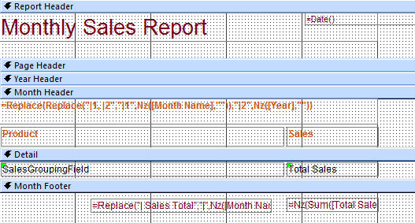
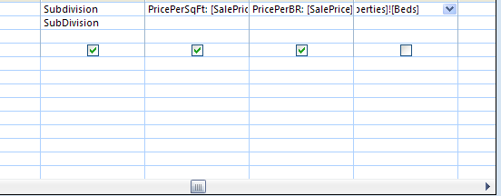
Table Design Considerations – Avoid Calculated Fields
Calculated fields should be used mainly in queries and reports
Calculated fields in a query
Calculated field in a report
Notes:
Calculated fields should be used mainly in queries and reports. This is more efficient and allows for more accurate information.

Slide 34
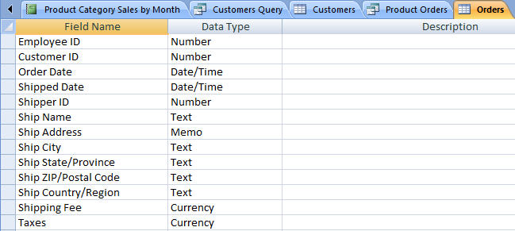
Table Design Consideration - Plan for Date Arithmetic
Fields declared as a data type of Date/Time
Using a data type of date/time for all date fields allows the use of date arithmetic
Example: DatePart(“q”, “01/22/2007”) (give the quarter number of 01/22/2007)
Notes:
Using a data type of date/time for all date fields allows the use of date arithmetic. An example of date arithmetic usage would be subtracting the shipping date from the order date of an item. The resulting number is the delay between the item being ordered and the item being shipped.

Slide 35
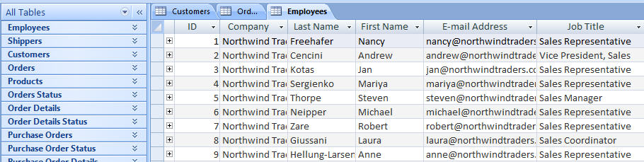
Table Design Considerations – Design Multiple Tables
Multiple tables shown in the Navigation pane
Multiple table tabs identify open tables
Using multiple tables helps reduce redundancy
  The process is also referred to as normalization
Notes:
Using multiple tables helps reduce redundancy. The process of reducing duplicate information is also referred to as normalization.

Slide 36
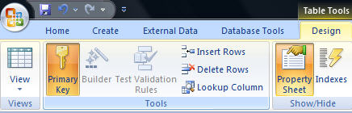
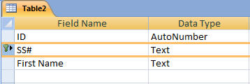
Create Tables – Primary Key
Primary Key icon
Primary Key Field
Tables are automatically created with an AutoNumber field which serves as the primary key
To change the primary key
  Select a field in Design View
  Click the primary key icon
Notes:
Tables are automatically created with an AutoNumber field which serves as the primary key. To change the primary key, select a field in Design View and click the primary key icon on the tools ribbon of the Design tab.

Slide 37
Create Tables – Consider a Foreign Key
Customer ID - Primary Key in Customer Table
Customer ID –will only appear in one record - there must only be one unique id per customer
Customer ID - Regular Field in Orders Table
Customer ID may appear many times – one customer can place many orders
Based on the above example:
  Customer Id is the foreign key in the Orders table
  This is referred to as a One to Many Relationship
Notes:
When planning your table always consider the possibility that you will need a foreign key. A foreign key in one table is the primary key in another and is created when a relationship between two tables is made.
Example:
Customer ID is the Primary Key in the Customer Table
Customer ID will only appear in one record in this table. There must only be one unique id per customer.
Customer ID is a Regular Field in the Orders Table
Customer ID may appear many times in this table. One customer can place many orders Customer ID may appear multiple times.

Slide 38
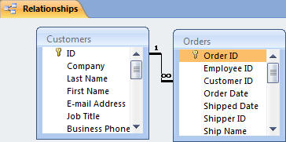
Working with Multiple Tables – Table Relationships
Relationship between two tables
The strength of Access is the fact that it is a relational database
  This means you can have multiple tables and create relationships between each table
  This helps eliminate redundant data
Notes:
The strength of Access is the fact that it is a relational database. This means you can have multiple tables and create relationships between each table. This is extremely important in the effort to eliminate redundant data.

Slide 39
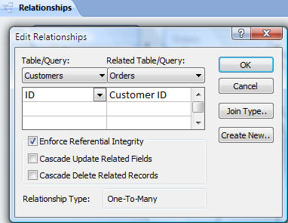
Working with Multiple Tables – Referential Integrity
Enforce Referential Integrity
Assures that the references to relationships between data is accurate
Established when creating the relationship between two tables
Notes:
Referential integrity helps assure that the references to relationships between data is accurate. It can be established when creating the relationship between two tables or at a later time by editing the relationship.

Slide 40
Working with Multiple tables - Cascades
Cascade update and cascade delete
When active, data changed in one table that is in a relationship will be changed in its related tables
Can be set when establishing relationships between tables
Notes:
When cascades are active, data changed in one table that is in a relationship will be changed in its related tables. Cascade Update means that data changed in one table will be changed in other tables that it shares a relationship with. Cascade delete means that if a record in is deleted in one table, the associated records in other tables it shares a relationship with will be deleted as well.

Slide 41
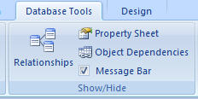
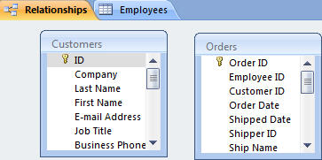
Establishing Relationships
Click and drag to create a relationship
Relationships icon
Click the Database tools and click the Relationships icon
In the Relationship window, click and drag a field name from one table to a field name in a related table
Notes:
Click the Database tools tab and click the Relationships icon in the Show/Hide group to open the Relationships window.
In the Relationship window, click and drag a field name from one table to a field name in a related table.

Slide 42
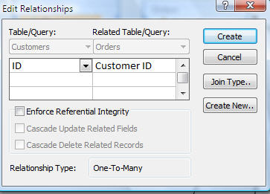
Establishing Relationships
Infinity symbol notes referential integrity has been applied
Set referential integrity and cascades
Enter the appropriate settings in the Edit relationships dialog box and click Create
A join line will appear when one table is joined to another
Notes:
After dragging a field name from one table to another, the Edit Relationships dialog box will appear. Enter the appropriate settings in the Edit relationships dialog box and click Create. A join line will appear when one table is joined to another. An infinity symbol be on the join line when referential integrity has been applied.

Slide 43
cascade – a strategy to enforce referential integrity
Employee
ssn
...
123456789
...
delete
Works-on
Essn
Pno
123456789
5
...
...
delete

Slide 44
cascade – a strategy to enforce referential integrity
Employee
ssn
... ...
supervisor
123456789
234589710
... ...
234589710
null
delete
Employee
ssn
... ...
supervisor
not reasonable
123456789
234589710
... ...
delete
234589710
null
delete

Slide 45
Modify – a strategy to enforce referential integrity
Employee
ssn
...
123456789
...
delete
Works-on
Works-on
Essn
Pno
Essn
Pno
123456789
5
null
5
...
...
...
...
This violates the entity constraint.

Slide 46
Modify – a strategy to enforce referential integrity
Employee
ssn
...
123456789
...
delete
Department
Department
Dno
...
chairman
Dno
...
chairman
5
123456789
5
null
...
...
This does not violate the entity constraint.

Slide 47
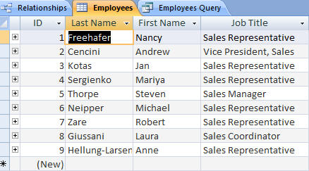
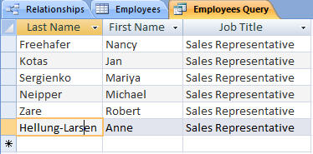
Queries
Dataset resulting from querying table for only employees who are Sales Representatives
Employees table
Queries allow us to ask questions about data
Notes:
Queries allow us to ask specific questions about the data and receive a record set back that answers our questions. This returned record set is called a dataset. Simply running a query does not change the actual table data. However, you may alter the data in a dataset and the changes will be reflected in the underlying table.

Slide 48
What Does a Query Do?
Queries let you pull just the data you need out of a database so you can perform tasks and get questions answered.
With queries, you can retrieve, combine, reuse, and analyze your data. You can use queries to retrieve data from multiple tables, or as a source for reports.

Slide 49
Understand the Question
When you work with queries, you need to keep in mind the questions that you want your data to answer.
The better you know the state of a database, the more precisely you can define the query.

Slide 50
Record Sets
Whenever you run a query, it checks for the latest data in your database. The data returned by a query is called a recordset/dynaset.
You can browse through the recordset, select from it, sort it, and print it.
The recordset you produce with a query isn't saved, but the query structure and criteria you used to get the results are saved.

Slide 51
Specifying Fields
The fields you specify for a query control the data that the query retrieves.
You can specify the fields you want whether you use the wizard or Design view.
The wizard prompts you to choose the tables or queries you want to use, and then which fields you want to use.
In Design view, you also start by choosing the tables or queries you want to use. Then you add each desired field to your query by dragging it from the table summary displayed above the grid.

Slide 52
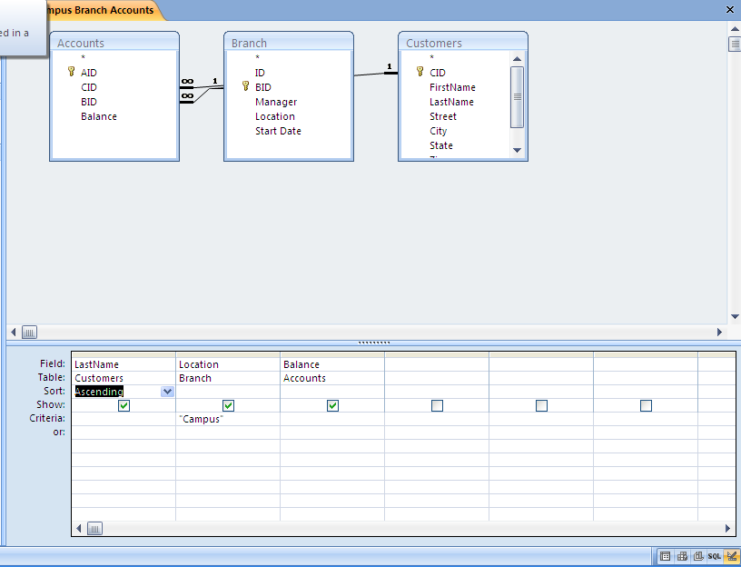

Slide 53
Criteria
Criteria are details you build into a query to identify the specific data you want to retrieve.
To do this, you would specify a criterion.
To set a criterion, you type the text or value that focuses the query into the Criteria row in the query grid.

Slide 54
Query Types
A select query retrieves data from one or more tables and displays the recordset in a datasheet. You can also use a select query to group data, and to calculate sums, counts, averages, and other types of totals.
A parameter query displays a dialog box when it runs, prompting the user to enter information to use as criteria for the query.
A cross-tab query arranges a recordset to make it more easily visible, using both row headings and column headings. Data can be seen in terms of two categories at once.
An action query creates a new table or changes an existing table by adding data to it, deleting data from it, or updating it.
An SQL query is created by using a statement in Structured Query Language (SQL).

Slide 55
Wizard/Design View
As with forms and reports, Access provides two basic ways to create queries: by using a wizard, and in Design view.
The wizard, also known as the Simple Query Wizard, gives you a head start in setting up your query's structure by making some arrangements for you.
In Design view you have total control when creating a query. You drag the fields you want to a grid, and then you enter the criteria for selecting the data to be retrieved.

Slide 56
Design View
In Design view, you begin by choosing the tables or existing queries that contain the fields you want to use.
Then, you select and drag those fields to a grid. The fields can come from just one table, or from multiple tables.
After you have added your fields, you can specify criteria and other settings, such as whether to sort the results.

Slide 57
Hiding Fields
Sometimes you'll prefer not to display all the data that a query retrieves. The information may not be necessary, or you may not wish to advertise the criteria that you used in the query.
The Show box lets you decide whether to display each field used in your query. You can display or not display a field, whether or not you have specified a criterion for that field.

Slide 58
Running a Query
You can test a new query in Design view.
The Run button on the Query Design toolbar. This will switch you to the results view.

Slide 59
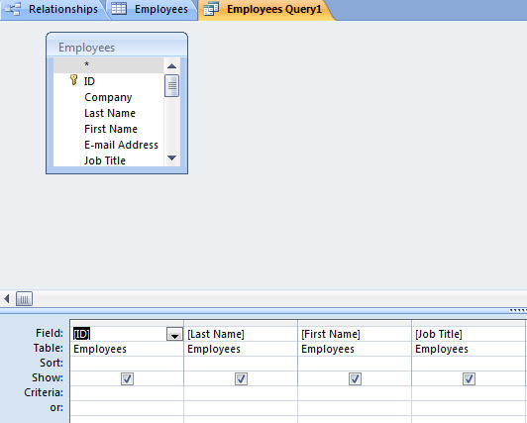
Using Query Design View
Tables pane
Design pane
Query Design grid has two panes – the table pane and the design pane
Striking the F6 key will toggle you between sections
Notes:
Query Design view has two panes – the table pane and the design pane. Striking the F6 key will toggle you between panes.

Slide 60
Select Query
Searches associated tables and returns a dataset that matches the query parameters
Notes:
A select query is a basic query that searches associated tables and returns a dataset that matches the query parameters
Changes made to the dataset will be reflected in the associated tables.

Slide 61
Specifying Criteria in a Select Query
Fields in design grid allow us to specify criteria for the dataset
Field row – displays the field name
Sort row – enables you to sort the dataset
Show row – controls whether or not you see a field in the dataset
Criteria row – determines the records that will be selected for display
Notes:
Parts of the Design Grid include:
Field Row – displays the field name
Sort row – enables you to sort the dataset
Show Row – controls whether or not you see a field in the dataset
Criteria row – determines the records that will be selected for display

Slide 62
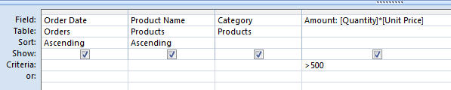
Specifying Criteria – Currency and Operands
Currency amount entered without dollar sign
Greater than (>) operand
Specify criteria with currency
  Without the dollar sign
  With or without the decimal point
Use operands such as:
  Less than and greater than
  Equal to or not equal to
Notes:
Specify criteria with currency without the dollar sign and with or without the decimal point. Use operands such as less than, greater than, equal to or not equal to, in order to compare your criteria against data in the specified field.

Slide 63
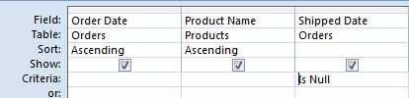
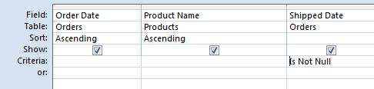
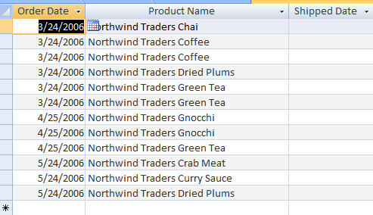
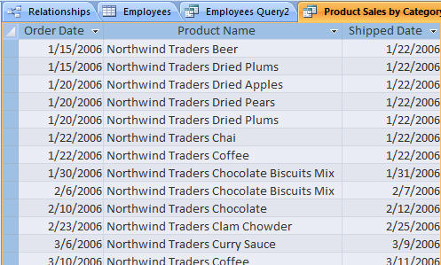
Specifying Criteria – Null Values
Is Null criteria and resulting dataset
IS NOT NULL criteria and partial resulting dataset
IS NULL finds only records that have no value
IS NOT NULL excludes Null value records
Notes:
Specify IS NULL in the criterion field to find fields that have no data. Specify IS NOT NULL to exclude Null value fields from the dataset.

Slide 64
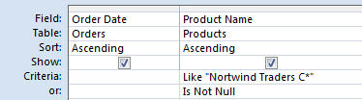
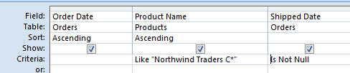
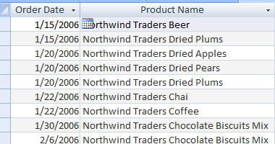
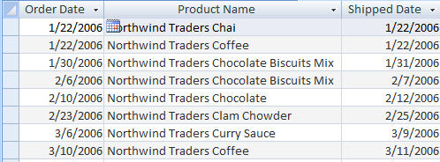
Specifying Criteria – And and Or
Or Criterion and resulting dataset
And criterion and resulting dataset
OR finds records that can match one or more conditions
AND finds records that must match all criteria specified
Notes:
Use the OR criterion to find records that can match one or more conditions specified. Use the AND criterion to find records that must match all criteria specified.

Slide 65
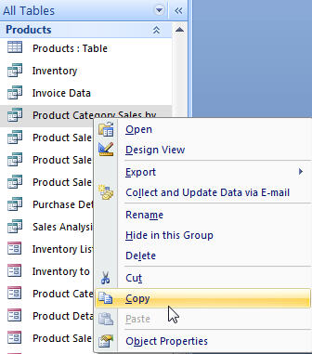
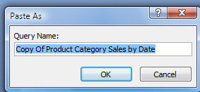
Copy a Query
Right click on the query - chose Copy from the shortcut menu
Right click and chose paste
In the Paste as dialog box, give the query a new name
Notes:
One way to copy is query is to right click on the query in the Navigation pane and chose Copy from the shortcut menu. Right click again in the navigation pane and chose paste. In the Paste as dialog box, give the query a new name.

Slide 66
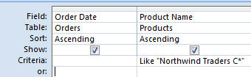
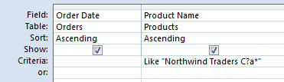
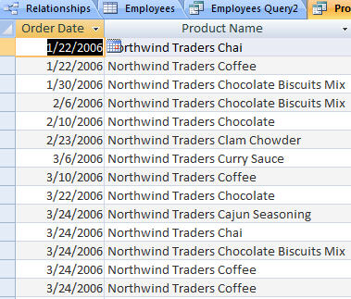
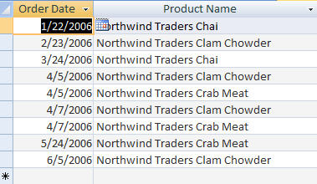
Specifying Criteria – Wildcards
Query with question mark and asterisk wildcard and resulting dataset to specify criteria for the dataset
Query with asterisk wildcard and resulting dataset
Asterisk - searches for a pattern that includes any number of characters in the position of the asterisk
Question mark - searches for a pattern that includes a single character in the position of the question mark
Notes:
The asterisk wildcard searches for a pattern that includes any number of characters in the position of the asterisk.
The question mark searches for a pattern that includes a single character in the position of the question mark.

Slide 67
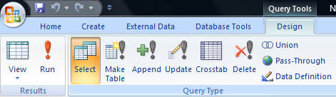
Run a Query
Run command
Running, or executing, a query is done by clicking the Run command
Notes:
Running, or executing, a query is done by clicking the Run command located by clicking the Design tab and accessing the Results group.

Slide 68
About Parameter Queries
Information intentionally omitted by designer
  Allows end user to supply criteria
  Customizable data request
More flexible than other query types
Considered a select query
Designers able to lock query design

Slide 69
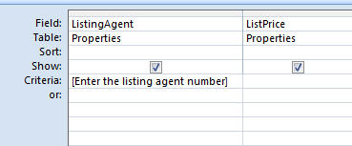
Creating a Parameter Query
Message for user entered in brackets
Identify tables/ fields in design view
Create prompt for user in criteria field
  Prompt must be enclosed in brackets [ ]
  Multiple fields can be used as prompts

Slide 70
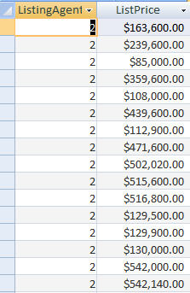
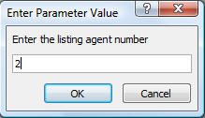
Running a Parameter Query
Message prompt with criteria entered
Parameter query results
Click the Run button
Enter criteria in message box
  Criteria rules and use is same as normal select query
View results in Datasheet view

Slide 71
The query prompts the user two times to type in two CIDs (account IDs).
Find any branch that has these two CIDs.

Slide 72
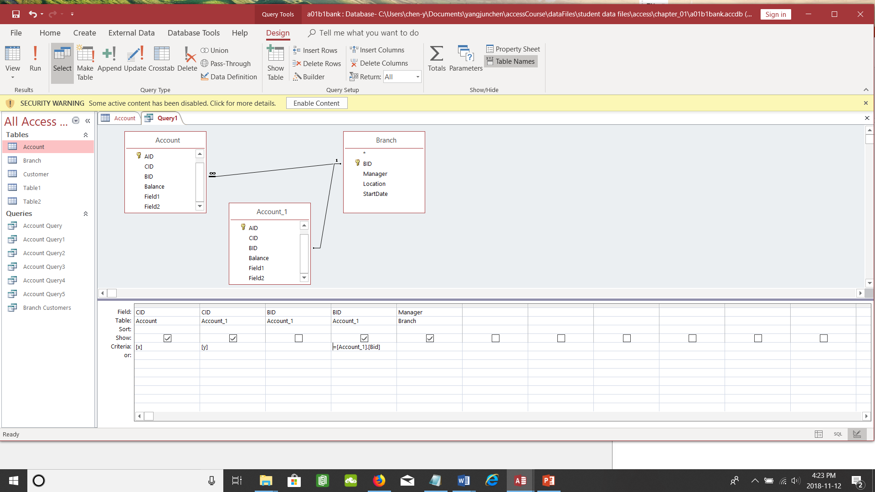

Slide 73
Parameter Report
Normally based of a parameter query
If not based on parameter query
  Open reports source query in design view
  Add parameter
  Or
  View report in Design
  Open property sheet for field
  Click Record Source property - add parameter

Slide 74
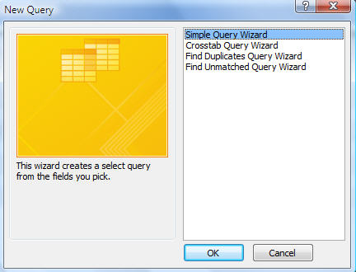

Creating Queries – Using the Query Wizard
Query Wizard icon
Select Simple Query Wizard
From the Create tab, choose Query Wizard for the Other group
Choose query type from the New Query dialog box
Notes:
To create a query using the Query Wizard, click the Create tab, choose Query Wizard from the Other group and choose the query type from the New Query dialog box.

Slide 75
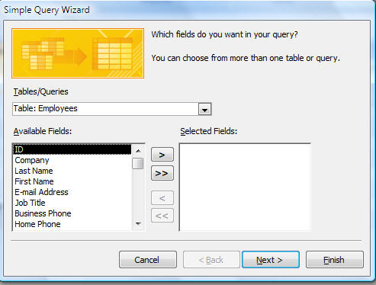
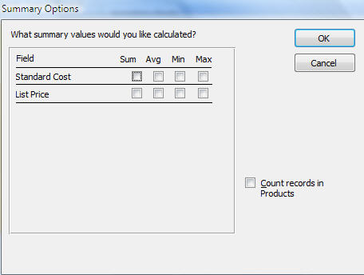
Creating Queries – Using the Query Wizard: continued
Select the Table/Queries to include and choose the desired fields
Select aggregate totals needed in the Summary Options box
Notes:
After establishing the type of query you wish to create, select the Table/Queries you wish to base your query on and choose the desired fields. Select aggregate totals you wish to display in the Summary Options box.

Slide 76
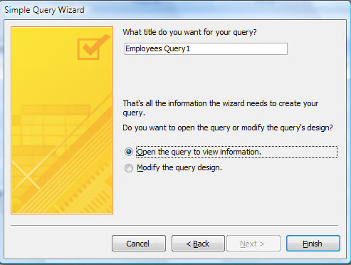
Creating Queries – Using the Query Wizard: continued
Title your query and open in Datasheet View or Query Design View
Notes:
The final step in using the Query Wizard is to name your query and open in Datasheet View or Query Design View.

Slide 77
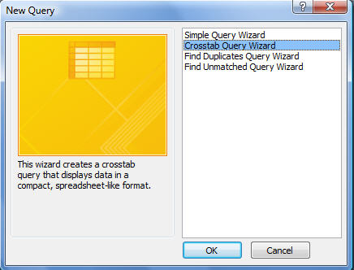
Crosstab Query – Using the Query Wizard Step 1
Select Crosstab Query Wizard
Click the Query Wizard button
In the New Query dialog box
  Select Crosstab Query Wizard

Slide 78
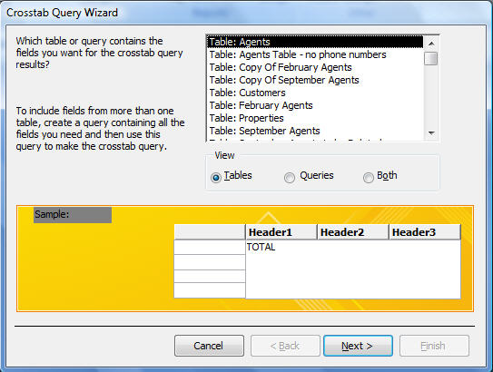
Using the Query Wizard Step 2
Select source table or query to use
Select table/query to use in crosstab
To use fields from multiple tables
  Create query from tables first

Slide 79
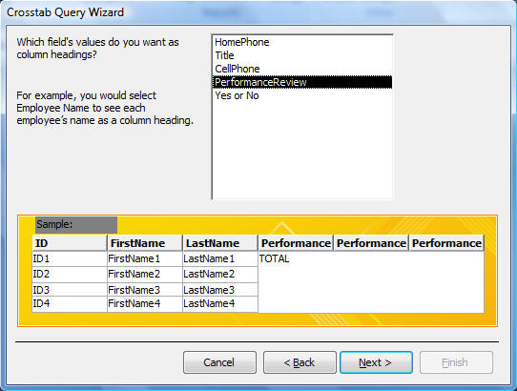
Using the Query Wizard Step 3
Select field(s) for column headings
Select fields(s) for column headings

Slide 80
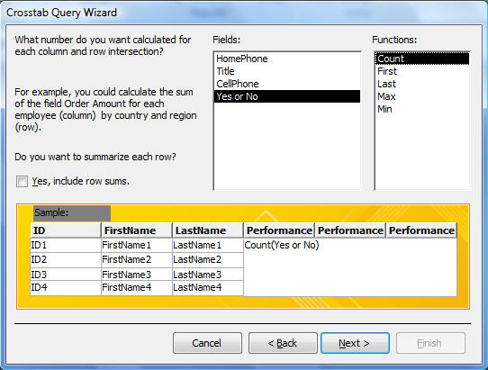
Using the Query Wizard Step 4
Select aggregate function
Select the field to calculate
Select the appropriate aggregate function

Slide 81
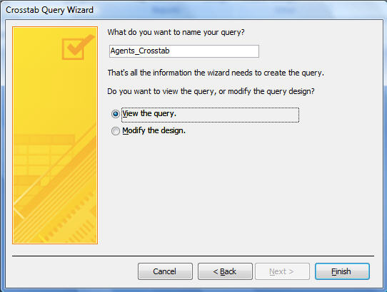
Using the Query Wizard Step 5
Enter new name or accept default name
Enter new query name or accept default
View or modify the query

Slide 82
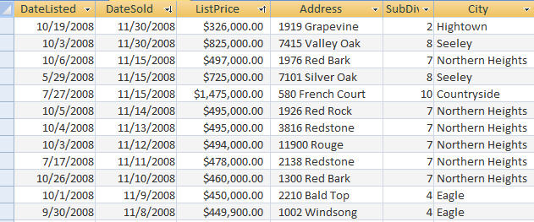
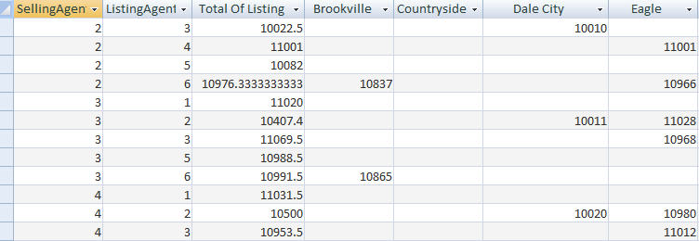
Completed Crosstab Query
Source table
Crosstab query
Summarizes list price
  Per selling/listing agent per city

Slide 83
Structured Query Language
SELECT fname FROM customer
WHERE lname=“Smith”
ORDER BY fname
SELECT DISTINCTROW Account.BID, Sum(Account.Balance) AS [Sum Of Balance]
FROM Account
GROUP BY Account.BID;

Slide 84
SQL- this is from Chapter 10 of text
Structured Query Language
Pronounced SEQUEL
Industry Standard for defining and processing database queries.
Created by IBM in the 1970’S
  Different versions
  ANSI/ISO Standard SQL/PSM SQL/Persistent Stored Modules
  SQL PL SQL Procedural Language (implements SQL/PSM)
  Microsoft/Sybase T-SQL Transact-SQL
  MySQL SQL/PSM SQL/Persistent Stored Module (implements SQL/PSM)
  Oracle PL/SQL Procedural Language/SQL (based on Ada)
  PostgreSQL PL/pgSQL Procedural Language/PostgreSQL Structured Query Language (based on Oracle PL/SQL)
  PostgreSQL PL/PSM Procedural Language/Persistent Stored Modules (implements SQL/PSM)

Slide 85
Structured Query Language
SQL statement
SELECT fname FROM customer;
Show (SELECT) me the records in the first name (fname) field that are in (FROM) the customer table
SQL
  Defines and process database queries
Microsoft Access SQL
  Microsoft version of SQL
Notes:
Structured Query Language, or SQL defines and process database queries. SQL is the industry standard query language and Microsoft Access SQL is Microsoft's version of SQL.

Slide 86
Database Analysis Tools
SELECT fname FROM customer
WHERE lname=“Smith”
ORDER BY fname
Returns records in the fname field only where the lname field is equal to Smith. Records are sorted in ascending order by first name
Clauses
  - Added to statements to restrict/specify records
WHERE clause
  - Specifies which records to return
ORDER BY clause
  - Specifies sort order
Notes:
Clauses can be added to select statement in order to restrict or further define query results. The WHERE clause specifies which records to return based on a condition – where this is equal to that or where this is true or that is false. The ORDER BY clause sorts records in either ascending or descending order and according to the field you specify. TO sort in descending order, add the keyword desc after the field name you are sorting by.

Slide 87
Structured Query Language
SELECT Orders.CustomerID, Orders.EmployeeID, Orders.OrderDate, Orders.Freight
FROM Orders
WHERE (((Orders.OrderDate)>#3/25/2010#)
AND (([Order Details].Quantity)>7)) OR (((Orders.EmployeeID)<7));

Slide 88
Structured Query Language
SELECT Orders.CustomerID, Orders.EmployeeID, Orders.OrderDate, Orders.Freight, [Order Details].Quantity
FROM Orders INNER JOIN [Order Details] ON Orders.OrderID = [Order Details].OrderID
WHERE (((Orders.OrderDate)>#3/25/2010#) AND (([Order Details].Quantity)>7)) OR (((Orders.EmployeeID)<7));

Slide 89
Inner Join and Outer Joins
        inner join - only matching tuples are in the result
        left outer join - all tuples of R are in the result regardless ...
        right outer join - all tuples of S are in the result regardless ...
        full outer join - all tuples of R and S are in the result regardless ...
R
S
R
S
R
S
R
S

Slide 90
Inner Joins
r1
r2
Α
Β1
Β2
C
a1
b1
b1
c1
a2
b2
b3
c3
a3
b3
b4
c4
r1
r2
B1=B2
Α
Β1
C
a1
b1
c1
a3
b3
c3

Slide 91
Left Outer Joins
r1
r2
Α
Β1
Β2
C
a1
b1
b1
c1
a2
b2
b3
c3
a3
b3
b4
c4
r1
r2
B1=B2
Α
Β1
C
a1
b1
c1
a2
b2
null
a3
b3
c3

Slide 92
Right Outer Joins
r1
r2
Α
Β1
Β2
C
a1
b1
b1
c1
a2
b2
b3
c3
a3
b3
b4
c4
r1
r2
B1=B2
Α
Β1
C
a1
b1
c1
a3
b3
c3
null
b4
c4

Slide 93
Full Outer Joins
r1
r2
Α
Β1
Β2
C
a1
b1
b1
c1
a2
b2
b3
c3
a3
b3
b4
c4
r1
r2
B1=B2
Α
Β1
C
a1
b1
c1
a2
b2
null
a3
b3
c3
null
b4
c4

Slide 94
List all the employees with the information on the stores at which they work.
SELECT *
FROM Employee LEFT OUTER JOIN Store ON (Store.storeId = Employee.Store);

Slide 95
SQL Server Management Studio
SQL Server Management Studio is an integrated environment for accessing, configuring, managing, administering, and developing all components of SQL Server.
SQL Server Management Studio combines a broad group of graphical tools with a number of rich script editors to provide access to SQL Server to developers and administrators.

Slide 96
SQL Server Management Studio includes the following general features:
Supports most administrative tasks for SQL Server.
A single, integrated environment for SQL Server Database Engine management and authoring.
Management dialogs for managing objects in the SQL Server Database Engine, Analysis Services, Reporting Services, Notification Services that allows you to execute your actions immediately, send them to a Code Editor, or script them for later execution.
A common scheduling dialog that allows you to perform action of the management dialogs at a later time.
Exporting and importing SQL Server Management Studio server registration from one Management Studio environment to another.

Slide 97
Understand Large Database Differences
Most large companies separate their database into front and back ends
  Front end – contains the objects needed to interact with data, but not the tables where the record values reside
  Back end – contains the tables where the data resides
Notes:
To ensure data integrity, to maintain security and to avoid mishaps, most large companies separate their database into front and back ends.
Front end – contains the objects needed to interact with data, but not the tables where the record values reside.
Back end – contains the tables where the data resides

